Slide 1
PROJECT TITLE
IBM HACKATHON PROJECT
Presented By:
Faculty name :DEEPNEEL MAJUMDAR
Student Name_1 : SWAYAM SWARUP PANDA
Student Name_2 :SOUMENDRA DAS
College Name & Department : VSSUT ,ETC

Slide 2
OUTLINE
Problem Statement
Technology used
Wow factor
End users
Result
Conclusion
Git-hub Link
Future scope
IBM Certifications

Slide 3
Problem Statement
Predicting heart attacks accurately is essential to reducing mortality and enhancing patient care. Predictive techniques used today frequently lack early detection and accuracy. Artificial Intelligence (AI) presents a promising means of improving forecast accuracy through multidimensional, complicated data analysis. To improve overall cardiovascular health management, lower death rates, and provide timely therapies, it is imperative to develop strong AI models for heart attack prediction.

Slide 4
Technology used
PYTHON
JUPYTER NOTEBOOK

Slide 5
IBM cloud services used
Watsonx.ai
StudioWatsonx.ai
RuntimeCloud object storage-PC
AI/Machine Learning

Slide 6
Wow factors
Integration of Watsonx.ai: By utilizing Watsonx.ai, the project taps into one of IBM's most advanced AI tools for business. Watsonx.ai provides a robust environment for building and deploying highly accurate machine learning models. Its ability to work with large datasets and adapt to new patterns is ideal for predicting heart attacks, where early detection and high accuracy are critical.
StudioWatsonx.ai: This feature simplifies the development process, allowing for the creation, training, and deployment of AI models in a user-friendly interface. It accelerates the model development lifecycle, enabling data scientists and healthcare professionals to focus more on improving model accuracy rather than on technical complexities.
Cloud Object Storage: By utilizing IBM Cloud Object Storage, the project ensures scalability and flexibility in managing large volumes of patient data. It offers reliable, cost-efficient storage solutions with fast access speeds, making it ideal for handling sensitive medical data.
AI/Machine Learning: The project's reliance on AI and machine learning allows for the analysis of complex and multidimensional data, identifying patterns and correlations that may not be immediately apparent through traditional methods. This leads to more accurate predictions and better insights into heart attack risk.
Cloud-based Infrastructure: Leveraging IBM's cloud services ensures that the project has access to reliable infrastructure that can scale with the demands of handling real-time data and running predictive models. It also enables secure data management, which is crucial when dealing with sensitive health data.
Early Detection and Accuracy: The project’s focus on improving heart attack prediction models addresses a significant gap in current predictive techniques. With advanced AI, it aims to identify warning signs early on, which can be crucial for timely intervention and better patient outcomes.

Slide 7
End users
Healthcare Providers (Doctors, Cardiologists): They can use the predictive model to assess patient risk and make more informed decisions regarding treatment and preventive measures.Hospitals and Clinics: Institutions can integrate this AI model into their systems to streamline patient care, improve outcomes, and reduce heart attack-related mortality.Patients: Individuals at risk for heart attacks benefit from more personalized, timely interventions that may save their lives through early detection.Medical Researchers: Researchers can leverage the model’s data insights to further study heart disease trends, identify new risk factors, and improve overall health strategies.Insurance Companies: They can use prediction data to assess patient health risks and better structure health insurance plans based on individual risk factors.Public Health Organizations: These entities can utilize the aggregated data to design public health initiatives aimed at reducing heart disease mortality.Pharmaceutical Companies: They can analyze prediction results to develop more effective drugs or interventions targeted at high-risk individuals.Data Scientists: AI and machine learning experts will refine and enhance the model by using complex datasets, ultimately improving predictive accuracy.Health IT Professionals: These users implement, maintain, and ensure the smooth functioning of AI models within healthcare infrastructure, ensuring data security and compliance.Government Health Agencies: They can leverage the data to create policies that improve cardiovascular health at a population level, working toward reducing national heart attack rates.

Slide 8
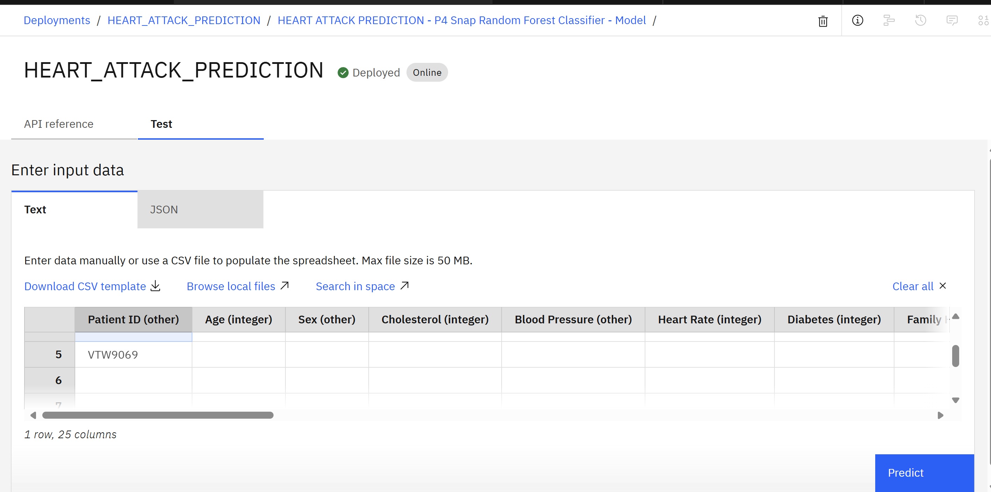
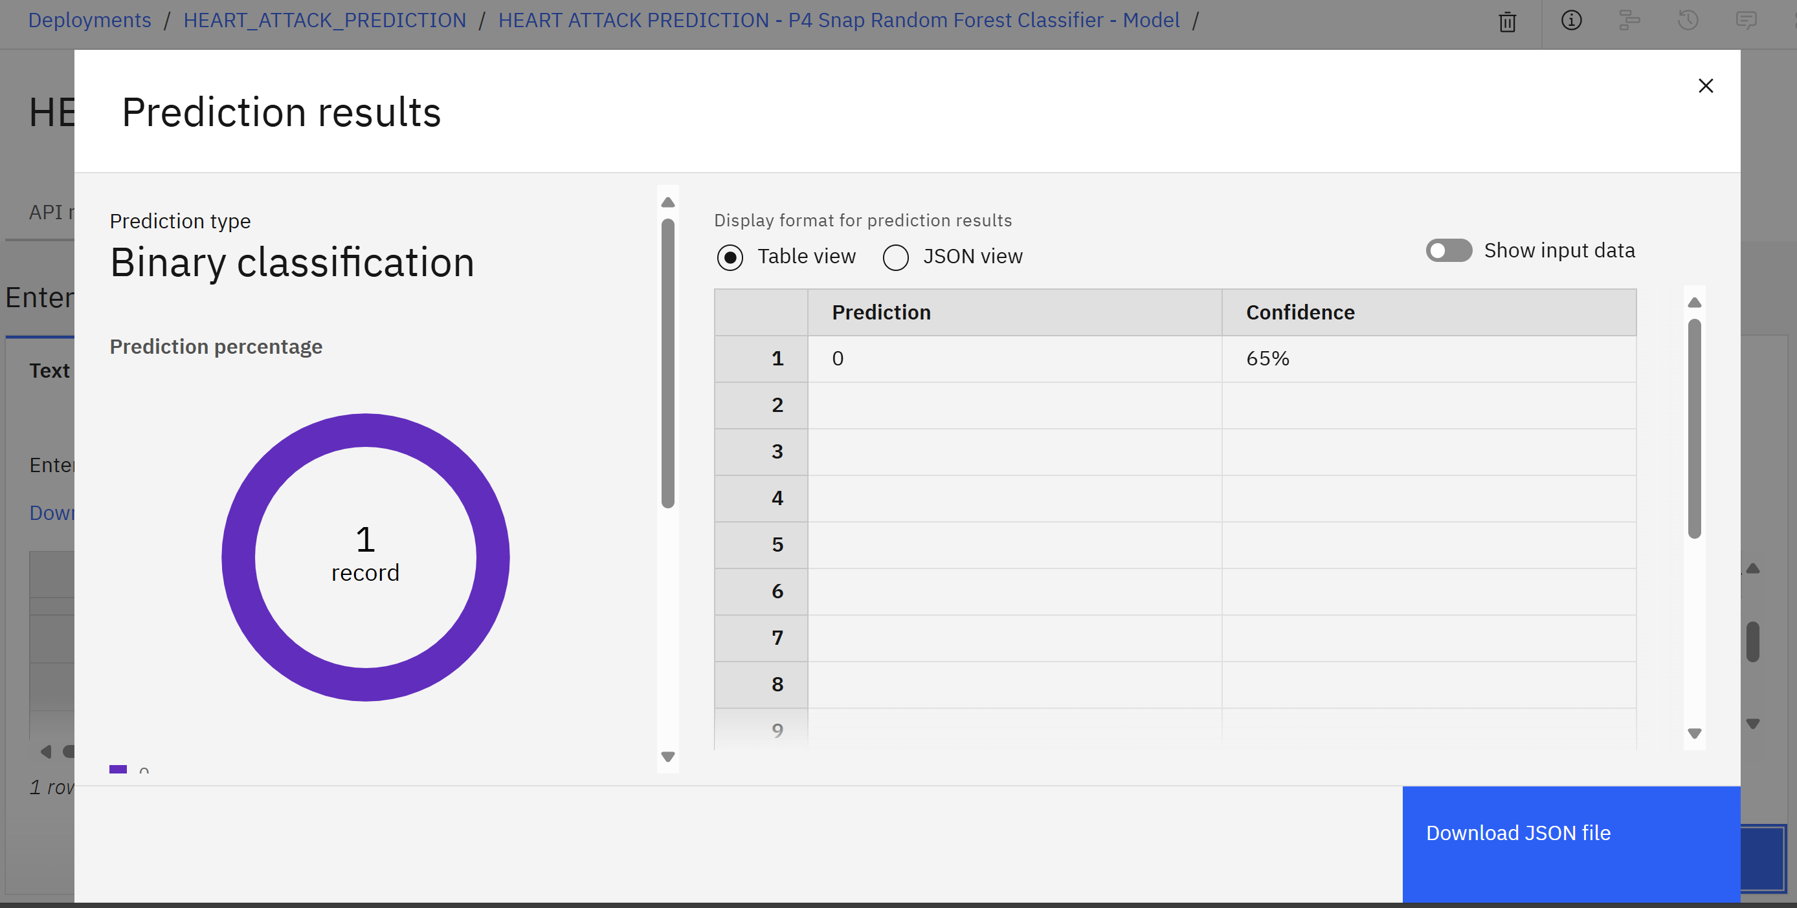
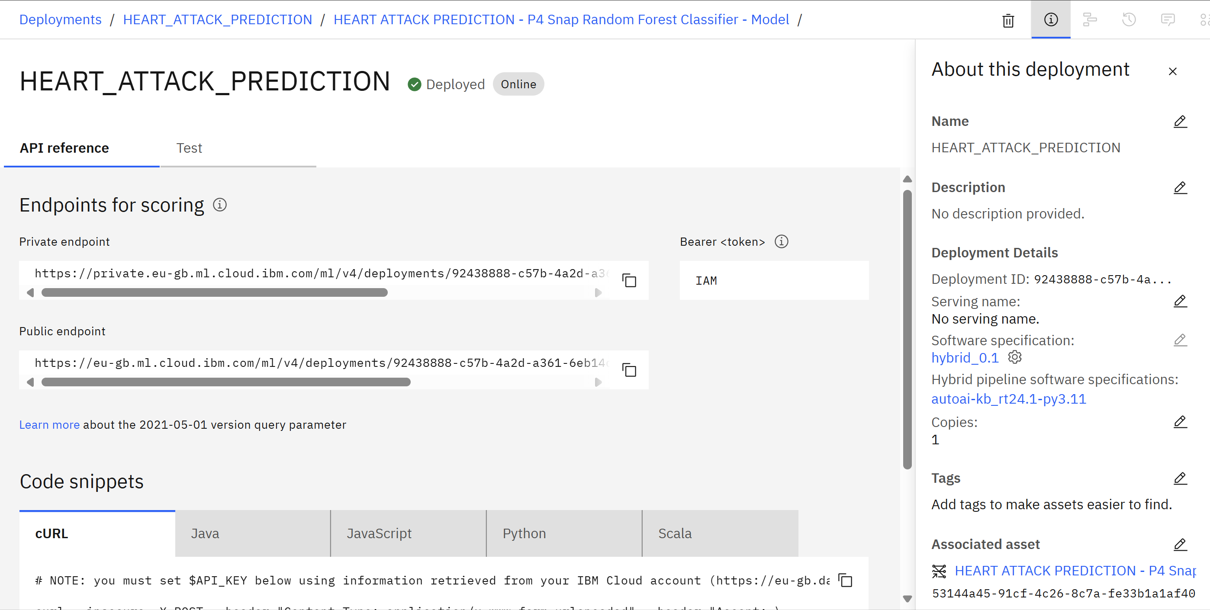
Results
Screenshots of the outcome (min 3)

Slide 9
Conclusion
In conclusion, this heart attack prediction project represents a significant advancement in healthcare, leveraging the power of AI and IBM's cutting-edge cloud technologies to enhance patient outcomes and reduce mortality rates. By utilizing tools like Watsonx.ai and IBM Cloud services, the project aims to provide early, accurate predictions of heart attacks, enabling healthcare providers to intervene sooner and tailor treatments to individual patient needs. This approach not only promises to improve the quality of care but also supports a more personalized healthcare system that can adapt to the unique risk profiles of each patient. With its scalable, cloud-based infrastructure, this project ensures that healthcare institutions, researchers, and patients alike can access and benefit from these predictive insights. Ultimately, this initiative has the potential to reshape the landscape of cardiovascular health management, leading to healthier populations and more effective, timely therapies for those at risk

Slide 10
GitHub Link
https://github.com/SWAYAMSWARUP-999/IBM-_INTRODUCTION-TO-AI

Slide 11
Future scope
Integration with Wearable Devices: As wearable health technology continues to advance, integrating real-time data from devices like smartwatches, fitness trackers, and medical sensors could provide continuous monitoring of heart health, enabling even earlier and more precise predictions.Global Health Impact: The model could be scaled to support healthcare systems worldwide, especially in regions with limited access to specialized cardiovascular care, helping to address heart disease on a global scale.Incorporation of Genomic Data: By integrating genetic information into the prediction model, the system could provide more accurate, personalized risk assessments based on a patient’s genetic predisposition to heart disease.Expanding to Other Cardiovascular Conditions: The model could be extended to predict other cardiovascular conditions like strokes, arrhythmias, or heart failure, broadening its applicability and improving overall heart health management.Predictive Analytics for Treatment Outcomes: Beyond just predicting heart attacks, AI could help forecast the success of different treatment options for patients, guiding physicians toward the most effective interventions.Collaboration with AI-powered Robotics: Integration with AI-powered robotic systems in healthcare could enhance surgical outcomes, enabling surgeons to perform more precise operations, like coronary artery bypass surgery, based on predictive insights.Real-time Decision Support Systems: The project could evolve into a real-time decision support tool in emergency rooms and intensive care units, offering AI-driven recommendations during critical moments based on patient data and predictive models.Improved Data Privacy and Security: Future advancements in data encryption and security protocols will ensure that sensitive health information remains protected, helping to meet global regulatory standards for patient data protection.Machine Learning Model Refinement: The predictive models can be continuously refined with more comprehensive datasets, leading to improved accuracy, reduced false positives, and better overall prediction rates as new techniques and data emerge.

Slide 12
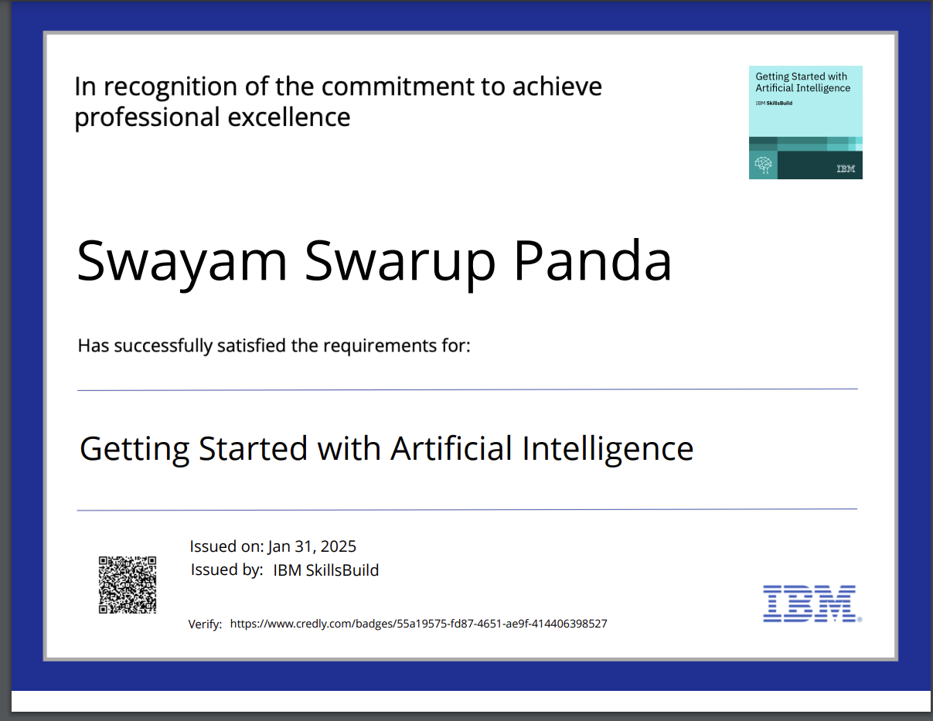
IBM Certifications

Slide 13
THANK YOU

